Slide 1


Top Discriminator Signal Over Bkg for several selection Categories NTUA
Giannis Papakrivopoulos
George Bakas

Slide 2
Signal Over Bkg
Signal over Background for
Mtt samples over Bkg
Nominal sample over Bkg
All histograms are vs mJJ (reco)
Categories:
1. Both jets are top tagged and b tagged
2. 1 Jet top and b tagged and other jet top tagged
3. 1 Jet top and b tagged and other jet b tagged
4. Both jets are top tagged
5. Both jets are b tagged
Cuts: nJets > 1, |jetEta| < 2.4 (bot jets), jetPt > 400 GeV (both jets)
120 GeV < jetMassSoftDrop < 200 GeV (both jets)

Slide 3
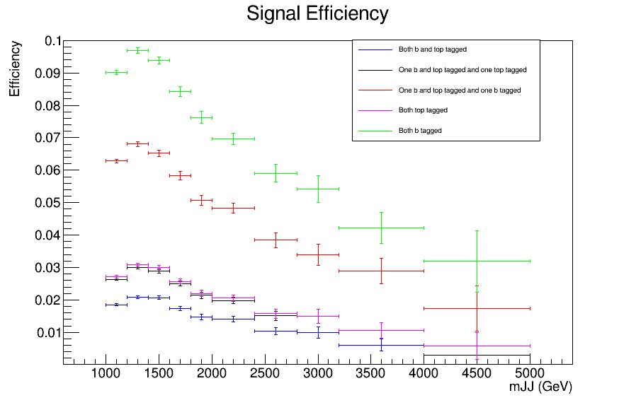
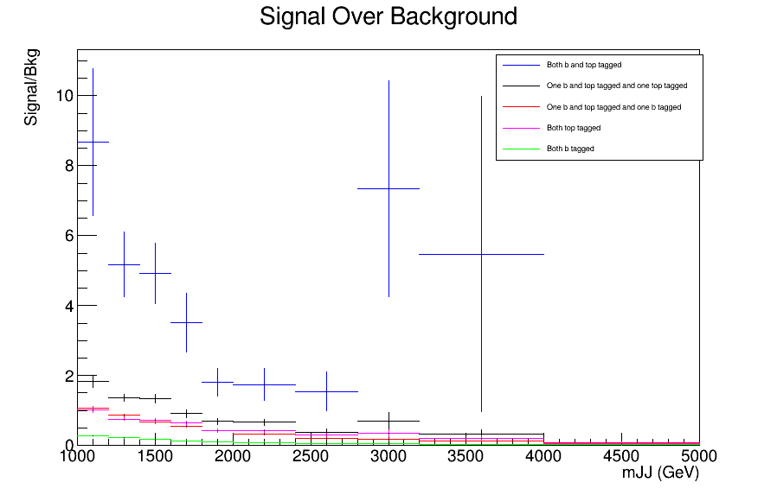
Signal over Bkg for mJJ (reco)
Top tagger cut : 0.6
B-tagging: loose working point
nominal TT_TuneCUETP8M2T4_13TeV-powherg-pythia8
Over Bkg (All Categories)

Slide 4
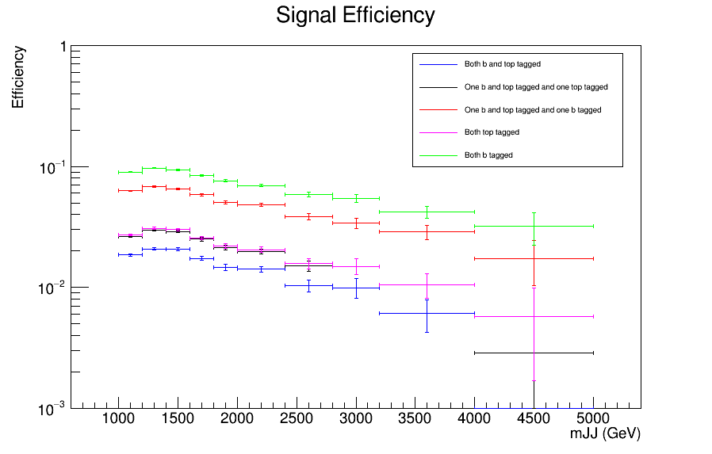
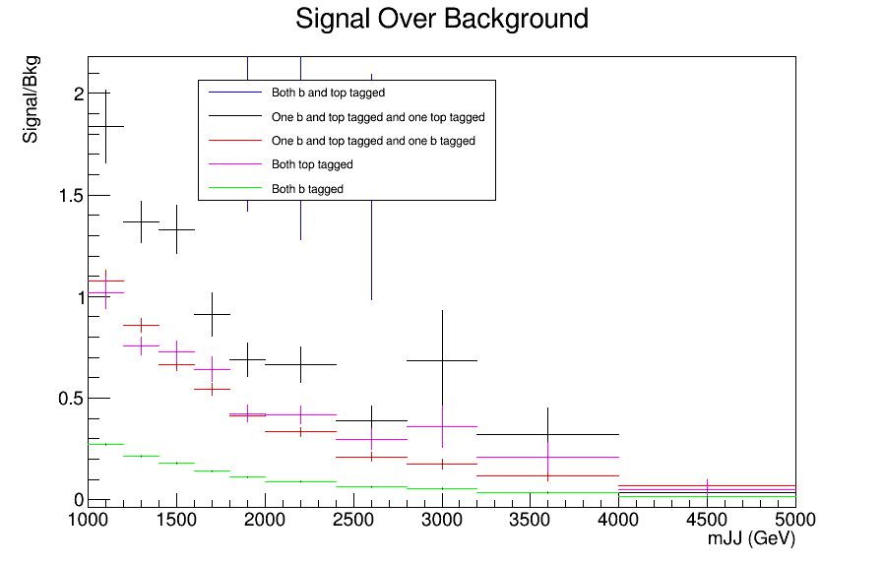
Signal over Bkg for mJJ (reco)
Top tagger cut : 0.6
B-tagging: loose working point
nominal TT_TuneCUETP8M2T4_13TeV-powherg-pythia8
Over Bkg (All Categories)

Slide 5
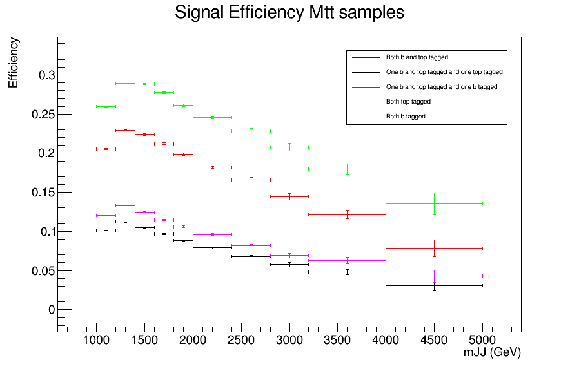
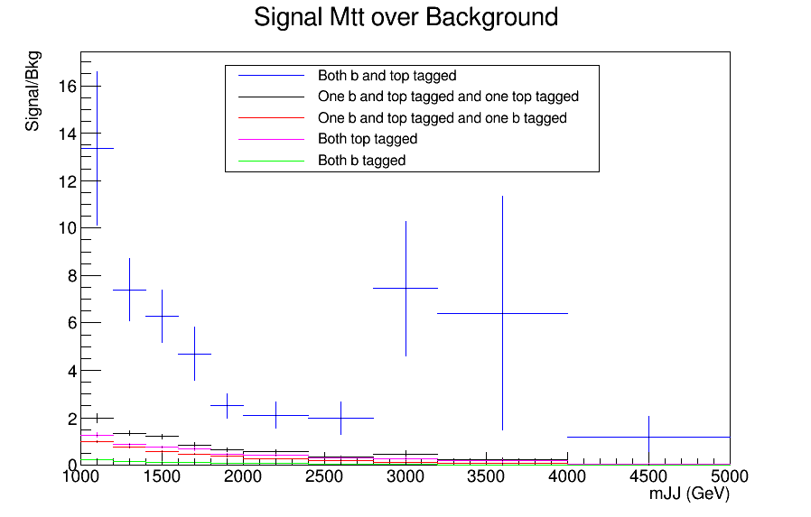
Signal over Bkg for mJJ (reco)
Top tagger cut : 0.6
B-tagging: loose working point
Mtt Samples

Slide 6
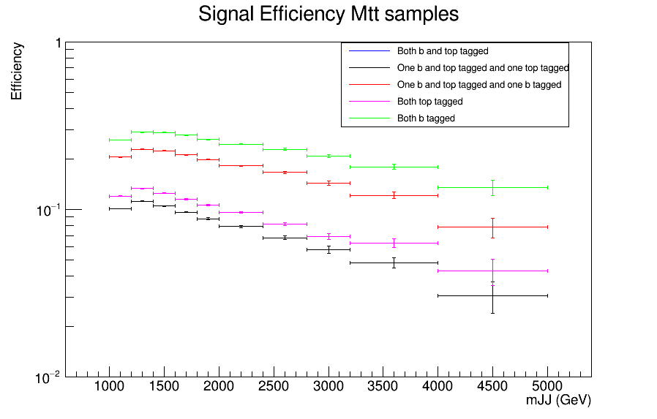
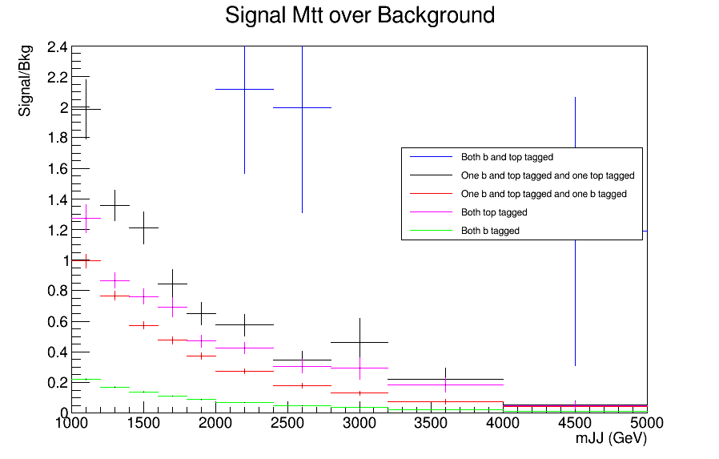
Signal over Bkg for mJJ (reco)
Top tagger cut : 0.6
B-tagging: loose working point
Mtt Samples

Slide 7
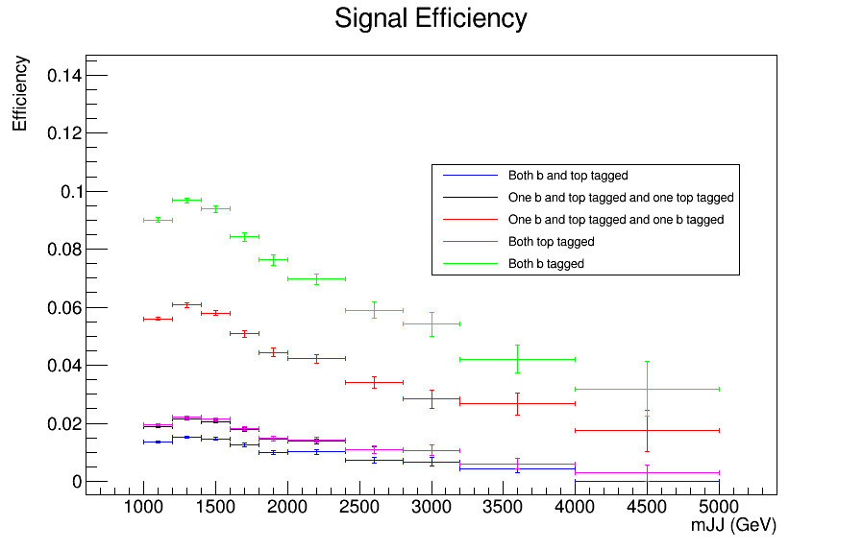
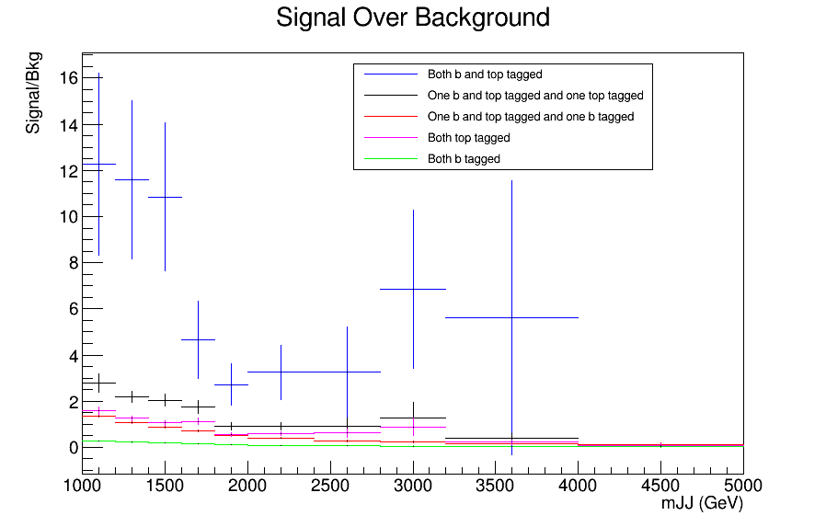
Signal over Bkg for mJJ (reco)
Top tagger cut : 0.7
B-tagging: loose working point
nominal TT_TuneCUETP8M2T4_13TeV-powherg-pythia8
Over Bkg (All Categories)

Slide 8
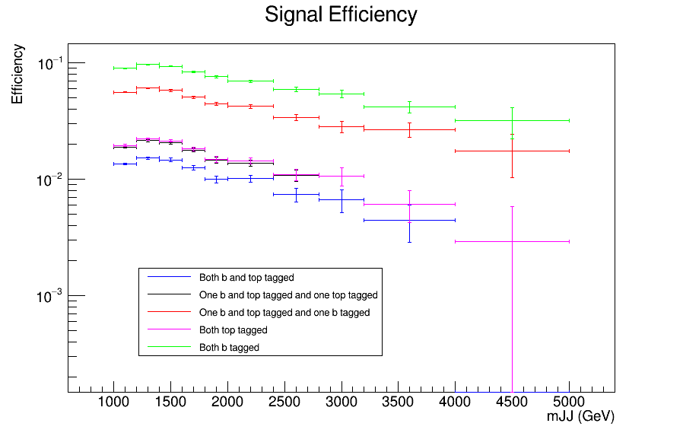
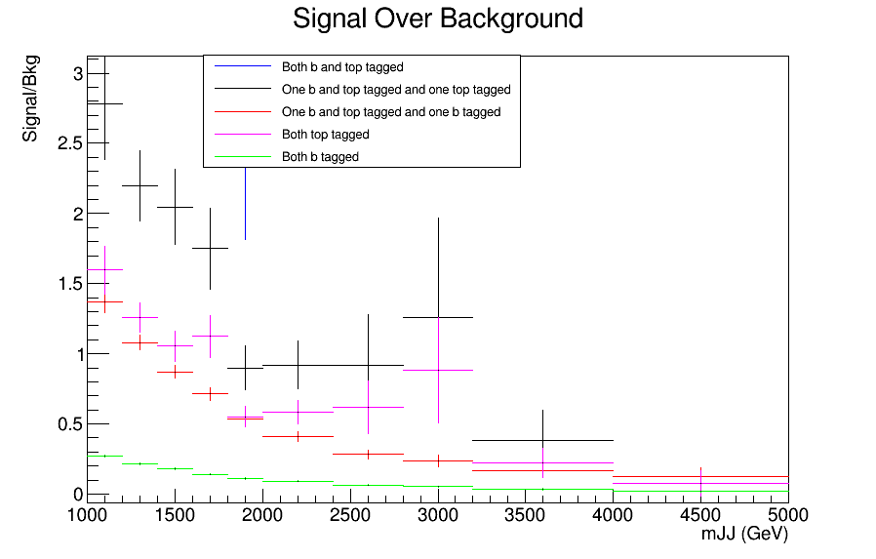
Signal over Bkg for mJJ (reco)
Top tagger cut : 0.7
B-tagging: loose working point
nominal TT_TuneCUETP8M2T4_13TeV-powherg-pythia8
Over Bkg (All Categories)

Slide 9
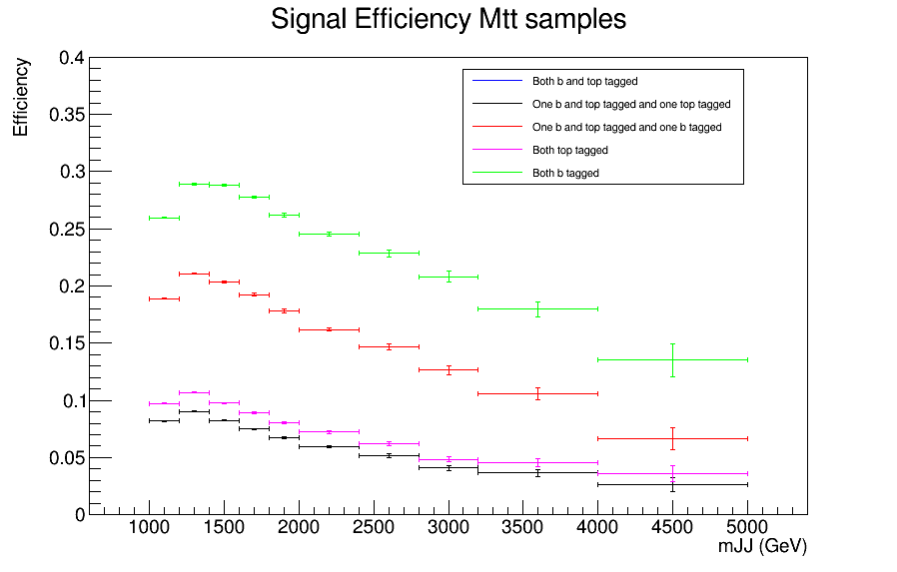
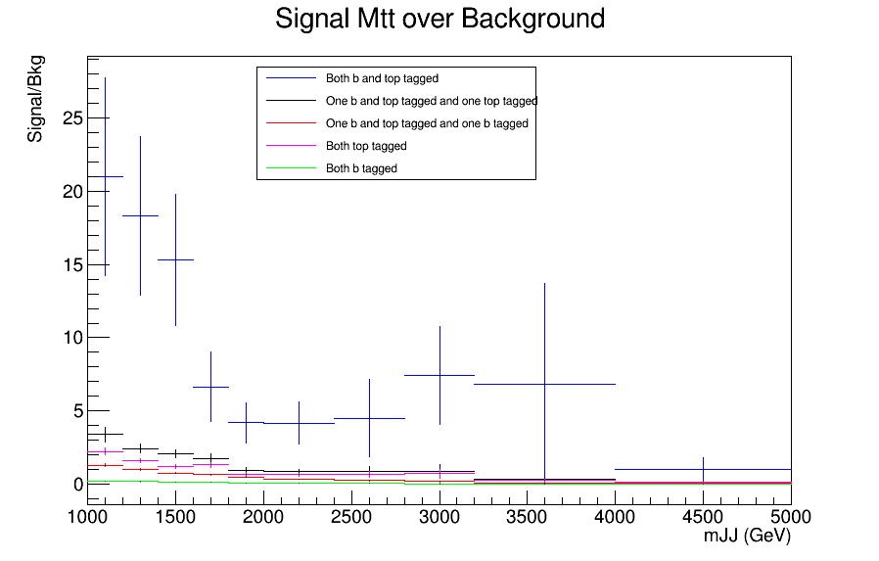
Signal over Bkg for mJJ (reco)
Top tagger cut : 0.7
B-tagging: loose working point
Mtt Samples

Slide 10
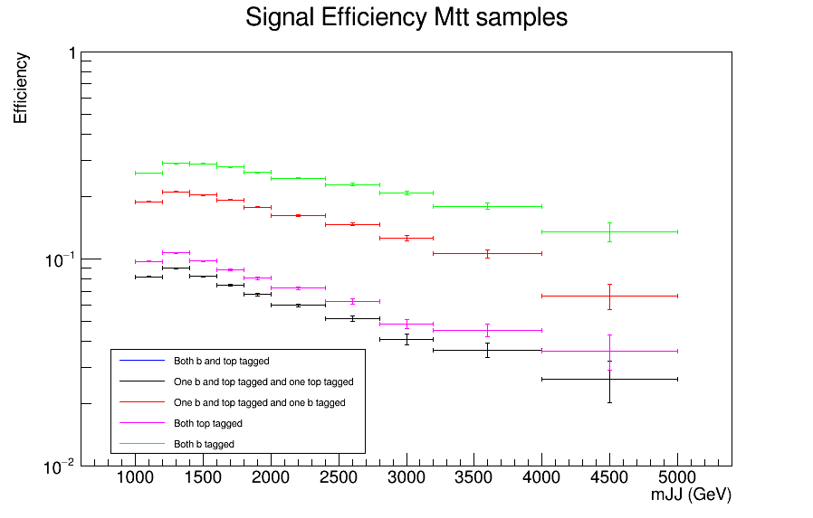
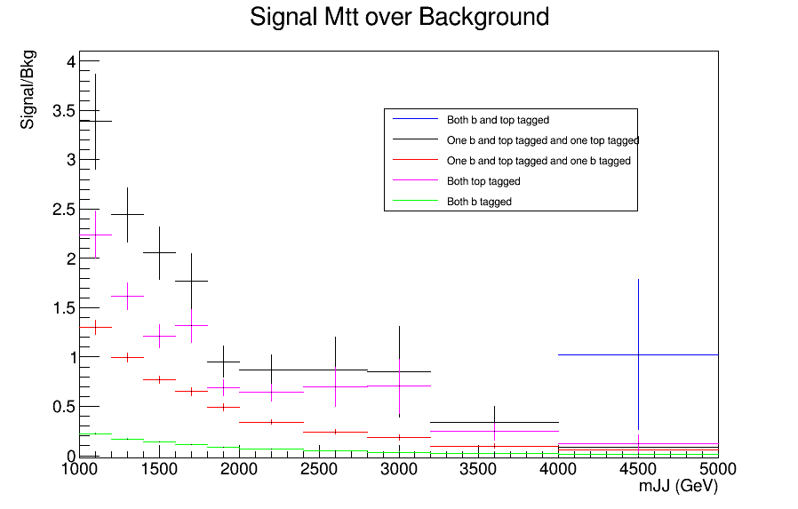
Signal over Bkg for mJJ (reco)
Top tagger cut : 0.7
B-tagging: loose working point
Mtt Samples

Slide 11
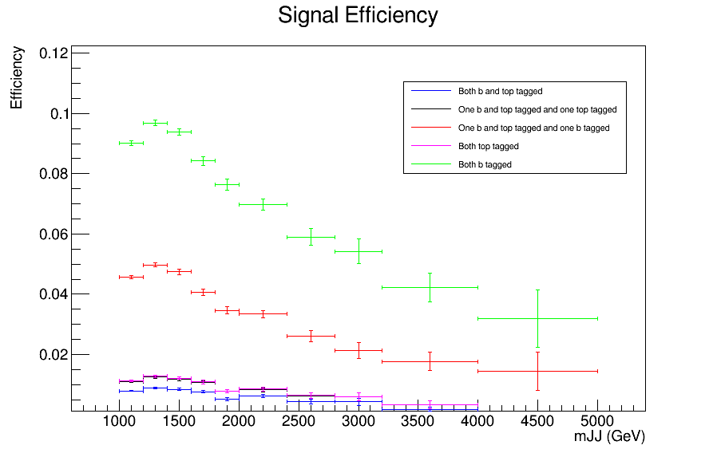
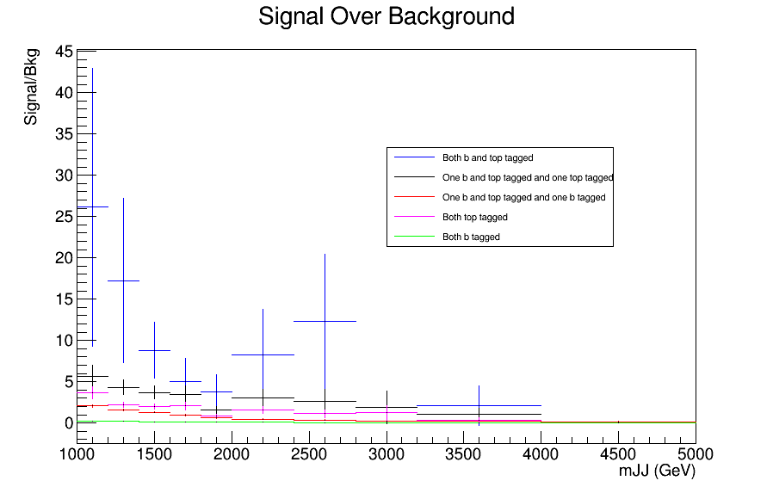
Signal over Bkg for mJJ (reco)
Top tagger cut : 0.8
B-tagging: loose working point
nominal TT_TuneCUETP8M2T4_13TeV-powherg-pythia8
Over Bkg (All Categories)

Slide 12
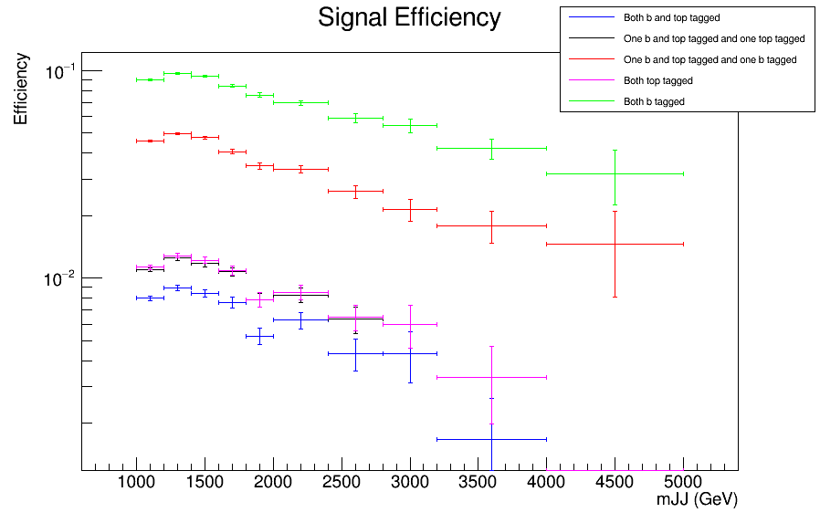
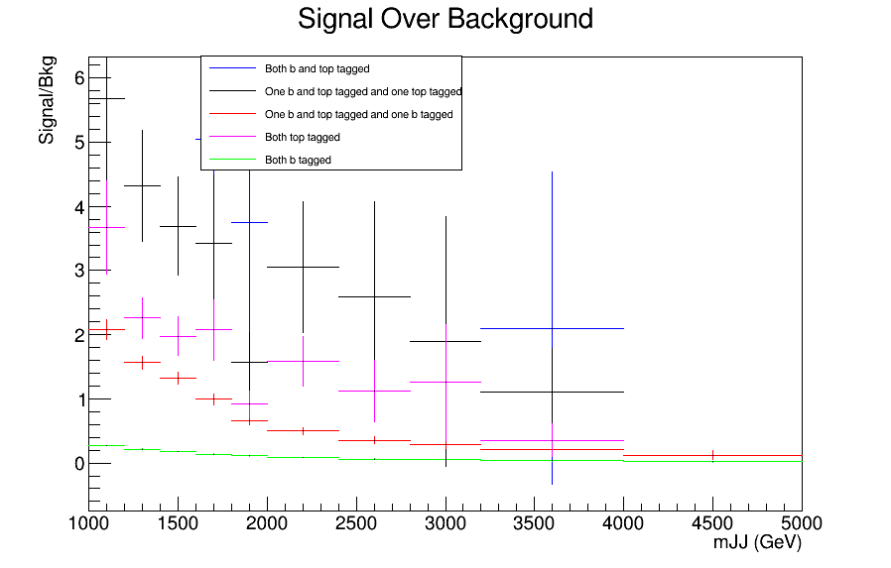
Signal over Bkg for mJJ (reco)
Top tagger cut : 0.8
B-tagging: loose working point
nominal TT_TuneCUETP8M2T4_13TeV-powherg-pythia8
Over Bkg (All Categories)

Slide 13
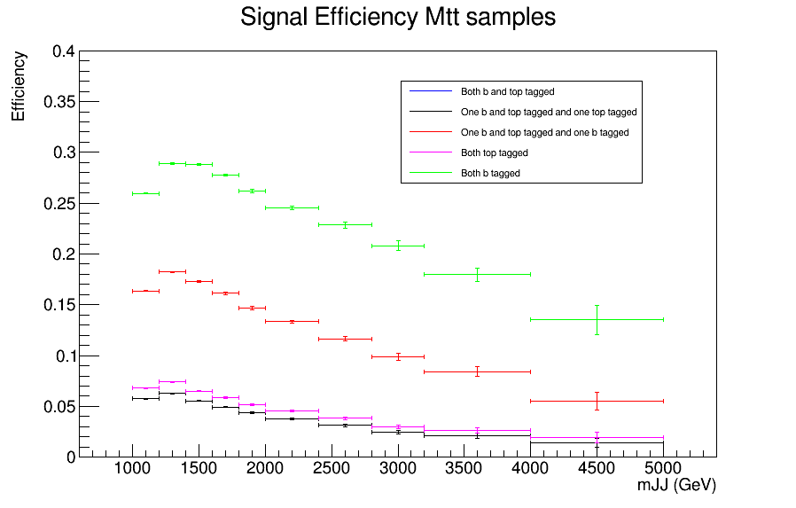
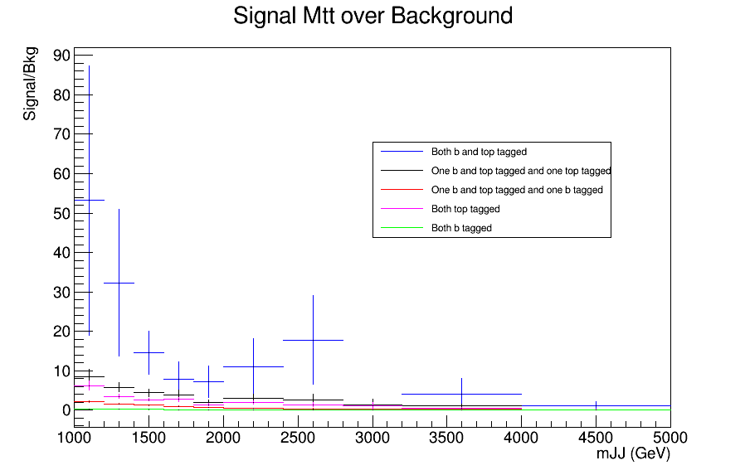
Signal over Bkg for mJJ (reco)
Top tagger cut : 0.8
B-tagging: loose working point
Mtt Samples

Slide 14
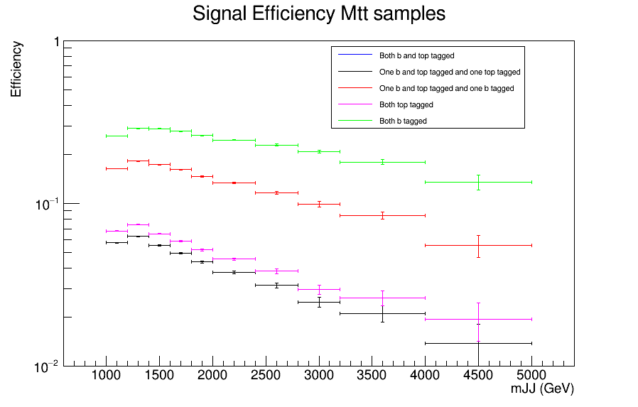
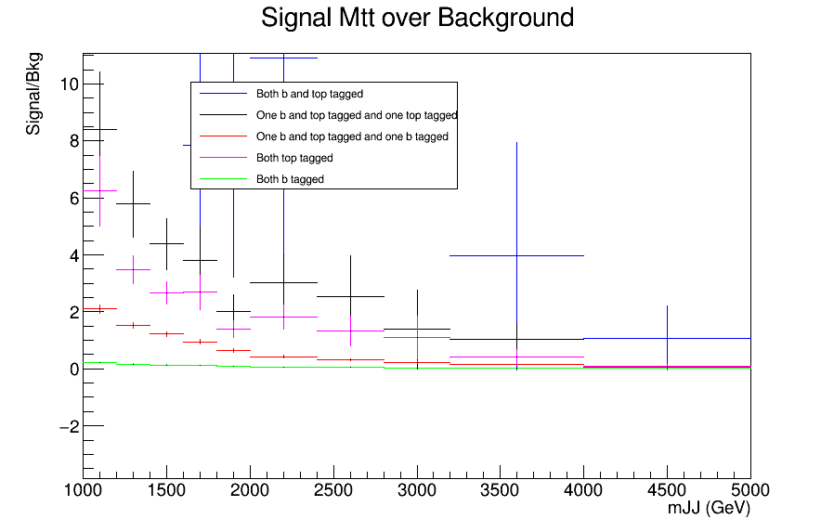
Signal over Bkg for mJJ (reco)
Top tagger cut : 0.8
B-tagging: loose working point
Mtt Samples

Slide 15
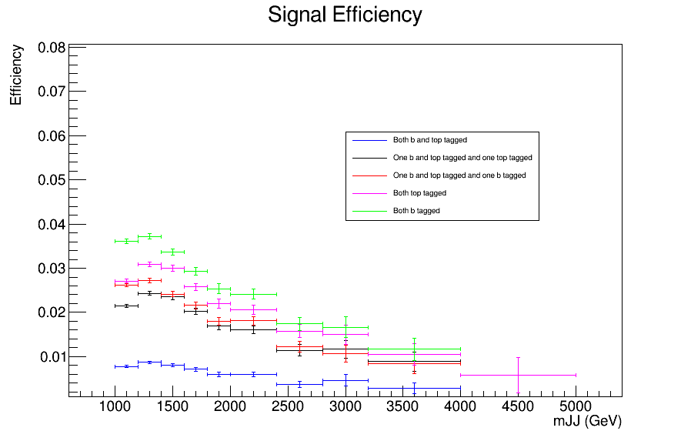
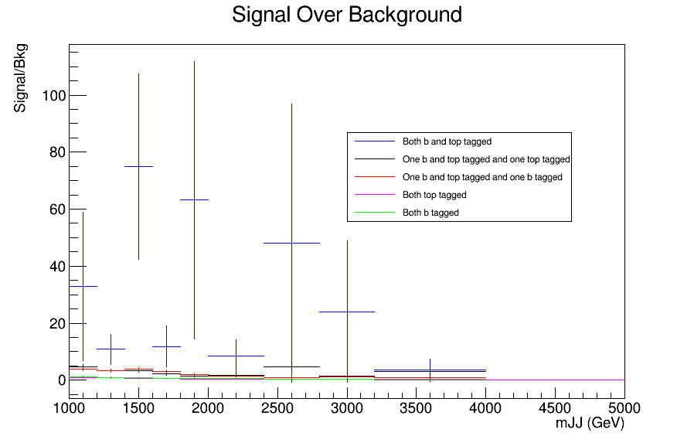
Signal over Bkg for mJJ (reco)
Top tagger cut : 0.6
B-tagging: Medium working point
nominal TT_TuneCUETP8M2T4_13TeV-powherg-pythia8
Over Bkg (All Categories)

Slide 16
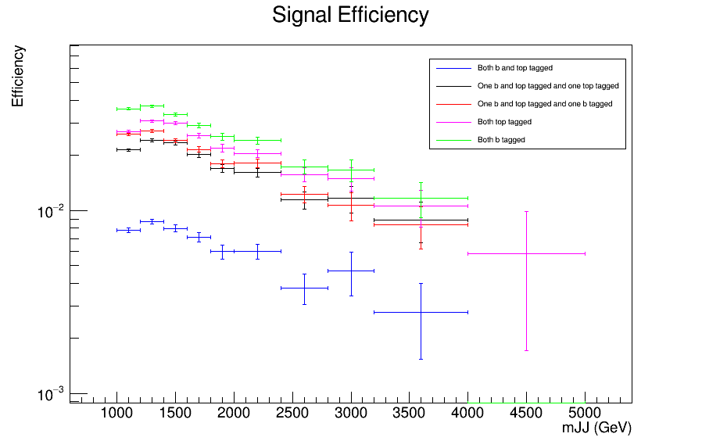
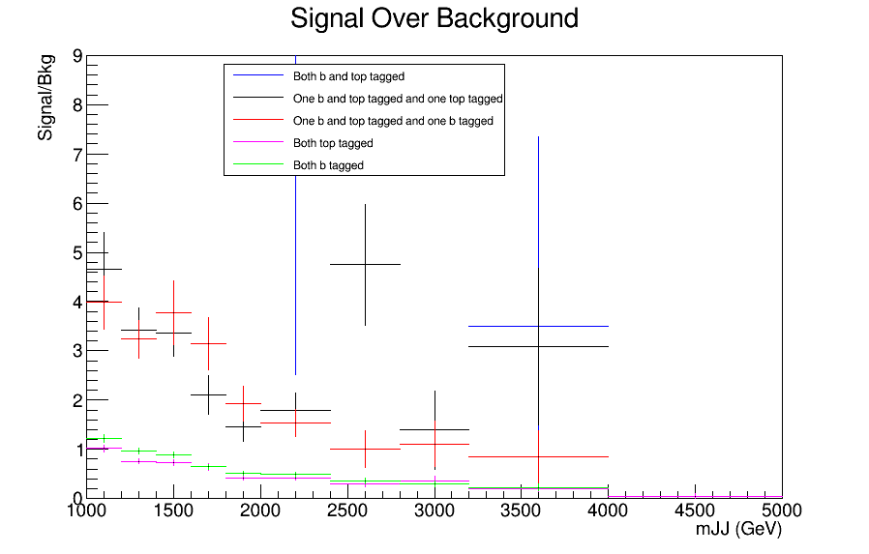
Signal over Bkg for mJJ (reco)
Top tagger cut : 0.6
B-tagging: Medium working point
nominal TT_TuneCUETP8M2T4_13TeV-powherg-pythia8
Over Bkg (All Categories)

Slide 17
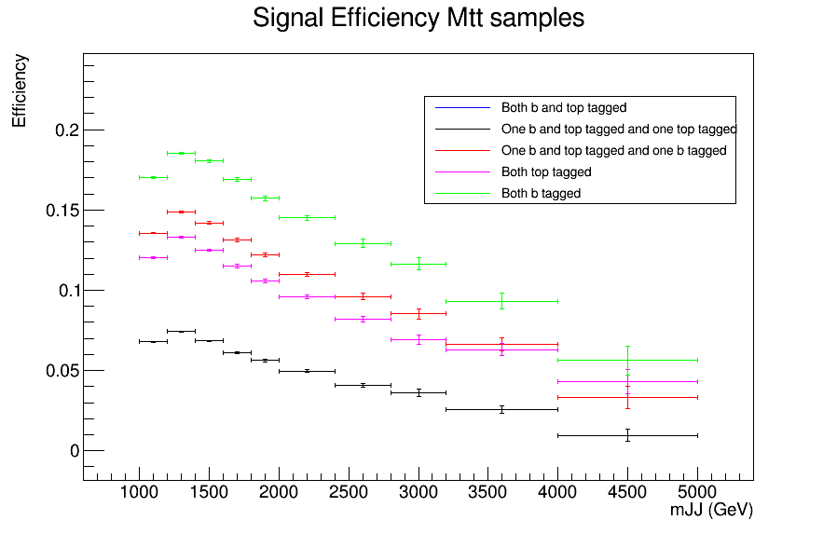
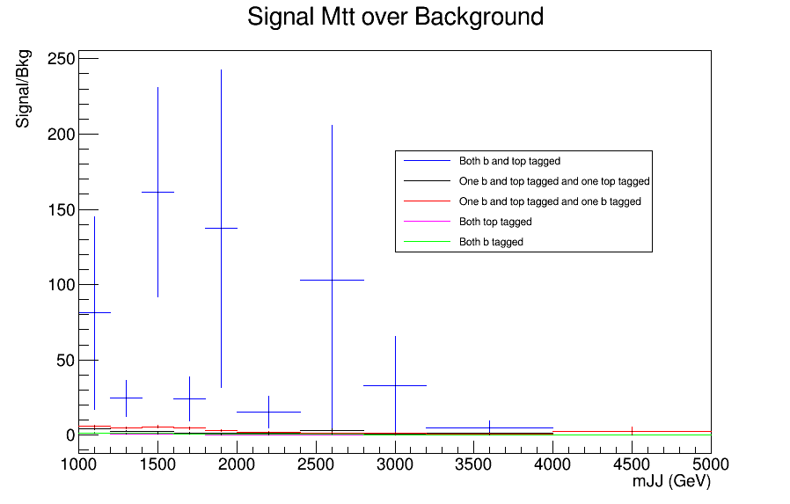
Signal over Bkg for mJJ (reco)
Top tagger cut : 0.6
B-tagging: Medium working point
Mtt Samples

Slide 18
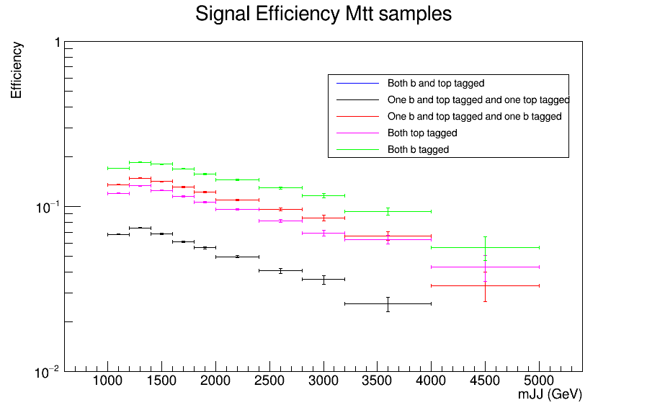
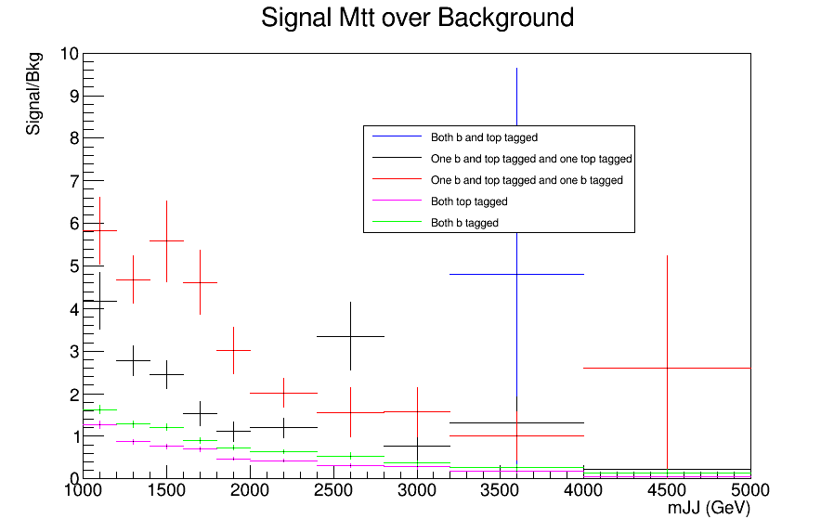
Signal over Bkg for mJJ (reco)
Top tagger cut : 0.6
B-tagging: Medium working point
Mtt Samples

